Slide 1

Tutorial on IQM Tools Pro
Advanced Clinical Trial Simulations
Integrated Solutions for Quantitative Drug Development
From Mechanistic Models to Complex Trial Simulation
Henning Schmidt, IntiQuan GmbH
5

Slide 2
Tutorial Outline
General introduction to the IQM Tools Suite
Overview Clinical Trial Simulation Approach IQM Tools
  Building blocks for simulations
  Models
  Dosing descriptions
  Sampling parameters from NLME parameter estimation results
Example 1: Parallel Design Simulation
Example 2: Adaptive Trial Simulation

Slide 3
Tutorial Info
In large parts you will have the opportunity to get hands-on-experience
>> installIQMtoolsInitial
Commands shown in these boxes should be entered on the MATLAB
command line, during the tutorial
********** MODEL NAME
Simple model
********** MODEL STATES
d/dt(Ad)= -ka*Ad + INPUT1
d/dt(Ac)= ka*Ad – CL/Vc*Ac
********** MODEL PARAMETERS
ka = 0.2
CL = 0.3
Vc = 6
********** MODEL VARIABLES
Cc = Ac/Vc
Text shown in these boxes should
be entered where appropriate
(will become clear later)

Slide 4
Tutorial Goal: „You should be able to“
Understand the components that are used by IQM Tools for general clinical trial simulation
Reuse the code from the two examples and adapt it to similar trial simulations of your interest

Slide 5
Tutorial Outline
General introduction to the IQM Tools Suite
Overview Clinical Trial Simulation Approach IQM Tools
Example 1: Parallel Design
Examples 2: Adaptive Trial Simulation

Slide 6
Introduction to the “IQM Tools Suite”
The IQM Tools Suite is provided freely and as open source
The IQM Tools Suite consists of two main packages
  IQM Tools Lite
  IQM Tools Pro
The whole is based on MATLAB (www.mathworks.com)
IQM Tools Lite
Model, experiment, measurement & dosing representation, simulation, analysis functions, optimization, signal processing, statistical functions, etc.
IQM Tools Pro
Systems biology/pharmacology and PMX functionality, clinical data analysis, nonlinear mixed effect modeling, clinical trial simulations, high speed simulation through transparent C-code interface

Slide 7
Modular Design of the IQM Tools Suite
MONOLIX
NONMEM
IQM Tools Pro (pmx) (population PKPD, workflows, trial simulation, ...)
IQM Tools Pro
(sys)
(parameter
determination
functionality)
GUI Functions
(Model editing, visualization, etc.)
IQM Tools Lite
Functions
(Analysis, Simulation, etc.)
Optimization
Algorithms
SUNDIALS
CVODES
Powerful
Solvers
Low-Level Functions
(creating, converting objects)
Signal Processing
functions
Statistical
functions
IQMprojectSB
IQMmodel / IQMmeasurement
IQMexperiment/IQMdosing
SBML
Toolbox
MEX
MATLAB
ODE FILE
..., ..., ...

Slide 8
Requirements
MATLAB R2013b (or later)
  Optional but very useful: Parallel Toolbox to allow for better runtimes of the examples
Required 3rd party software
  Monolix Version 4.2.3 (or later) (http://www.lixoft.org)
  NONMEM Version 7.2 (or later) (http://www.iconplc.com)

Slide 9

Where to get IQM Tool Suite from?
Free download of IQM Tools Suite available from the IntiQuan webpage
The IQM Tools Suite is distributed as a ZIP file with both IQM Tools Lite and IQM Tools Pro included
Unzip this ZIP file on your computer at a location where you want to store the IQM Tools
www.intiquan.com

Slide 10
How to Install the IQM Tool Suite?
Start MATLAB
Change into the “IQM Tools Suite” folder
Read and update custom information in setup files:
  IQMlite/SETUP_PATHS_TOOLS_IQMLITE.m
  IQMpro/SETUP_PATHS_TOOLS_IQMPRO.m
Execute the “installIQMtoolsInitial” script
You need to execute the “installIQMtoolsInitial” script once after obtaining a copy of IQM Tools. This will compile required libraries.
After this first installation, you can use the function “installIQMtools” to install IQM tools. This needs to be done each time you exit and start MATLAB again. This is on purpose for compliance and reproducibility reasons.
If you do not care about compliance, you might want to consider the use of a startup.m script (see http://www.mathworks.com/help/matlab/ref/startup.html).

Slide 11
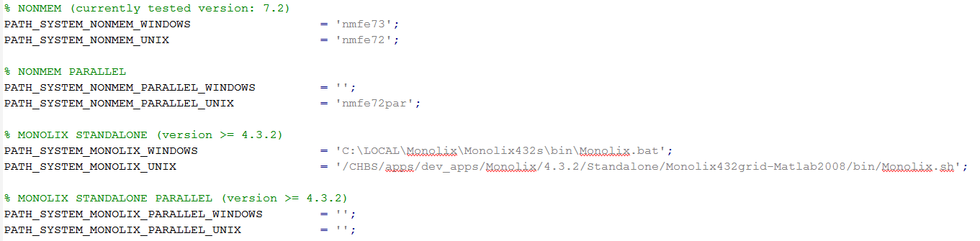
Installation of optional 3rd party software
Please follow the providers instructions when installing optional 3rd party software.
  Update the IQMpro/SETUP_PATHS_TOOLS_IQMPRO.m file with the relevant information, as shown below for an example implementation

Slide 12
IQM Tools’ Documentation
  MATLAB style help
IQM Tools Tutorials with examples
  Part 1: IQM Tools Lite (General Model Specification, Simulation, etc.)
  Part 2: IQM Tools Pro (MEX / Systems Biology/Pharmacology Projects)
  Part 3: IQM Tools Pro (Basic Pharmacometrics)
  Part 4: IQM Tools Pro (General Dataset Specification and PMX Workflows)
  Part 5: IQM Tools Pro (Advanced Clinical Trial Simulations)
  Part 6: IQM Tools Pro (Linking Systems Pharmacology Models to Clinical Data)
  IQM Tools – Workshops
    Given on demand and on some conferences during a year
>> help IQMlite
>> help IQMpro
>> help IQMsimulate
>> help IQMexportCSVdataset
>> doc IQMlite
>> doc IQMsimulate

Slide 13
Tutorial Outline
General introduction to the IQM Tools Suite
Overview Clinical Trial Simulation Approach IQM Tools
  Building blocks for simulations
  Models
  Dosing descriptions
  Sampling parameters from NLME parameter estimation results
Example 1: Parallel Design
Example 2: Adaptive Trial Simulation

Slide 14
Building blocks for simulations
With IQM Tools simulations are straight forward. From very simple ones (dosing schedules, as shown previously) to very complex clinical trial simulations
The underlying building blocks for any simulation are the following
NLME Project
Sample N sets
of parameters
Sampling can consider uncertainty, covariates, etc. Population or individual parameters can be sampled, depending on what the goal of the simulation is
NLMEproject contains the results of the parameter estimations (paramenter point estimates, correlation matrices, standard errors, variability distributions, transformations, covariates, etc.)
IQMmodel +
IQMdosing
Simulate IQMmodel
for sampled parameters
Postprocess and
display results
IQMmodel contains the mathematical model structure and the parameters that have been estimated in the NLME project
Simulation with the inbuilt simulator in IQM Tools allows fast integration and user friendly use. No simulation dataset needs to be generated. Even complex adaptive clinical trial simulations are just a couple of lines of code away

Slide 15
IQMmodel syntax linking the model to dosing inputs and observations in clinical data (for parameter estimation)
Same syntax as for IQMmodels
  ODEs or biochemical representation can be used
Additional elements
  INPUT*: Allows to define dosing inputs
********** MODEL NAME
Linear two compartmental distribution PK model
********** MODEL STATES
d/dt(Ac) = -CL/Vc*Ac – Q/Vc*Ac + Q/Vp*Ap + INPUT1
d/dt(Ap) = + Q/Vc*Ac - Q/Vp*Ap
********** MODEL PARAMETERS
CL = 20 % (L/hour) Clearance
Vc = 32 % (L) Central volume
Q = 12 % (L/hour) Intercompartmental clearance
Vp = 1450 % (L) Peripheral volume
********** MODEL VARIABLES
Cc = Ac/Vc % Calculation of plasma concentration
OUTPUT1 = Cc
Example model

Slide 16
IQMmodel Syntax - INPUTs
INPUT Definitions in IQMmodels
  Please open the example file inputExamples.m in the folder
  Example Files/MODEL_SYNTAX and work it through
  Example for a single input definition in an ODE based model (model1.txt)
  Example for a single input definition in an model based on biochemical reaction equations (model2.txtbc)
  Both models above are mathematically identical.
  The inputExamples.m file contains also a more complex input example
********** MODEL STATES
d/dt(Ac) = -VMAX*Cc/(KM+Cc) + F*INPUT1
********** MODEL REACTIONS
=> Ac : v_input
vf = F*INPUT1
Ac => : v_clearance
vf = VMAX*Cc/(KM+Cc)

Slide 17
IQMdosing Syntax
The IQM Tools allow to define dosing schedules in a simple but efficient format
The different dosing "inputs" then can be automatically applied to the inputs, defined in IQMmodels, using the INPUT* identifier
In this section we will explain how to define dosing schemes and how to merge them with models to simulate the desired dosing scheme on the desired model

Slide 18
IQMdosing Syntax
An example for a dosing scheme is the following
This dosing scheme defines that an INPUT1, defined in the model, should be implementing an infusion with a 14 day dosing interval, starting at time 0 with 5 repetitions, each dose 10 units and the infusion duration should be 2 hours
********** INPUT1
type: INFUSION
time: 0 % (days) time for first application
deltaT: 14 % (days) time inbetween applications
nr_repetitions: 5 % number of applications
D: 10 % (unit) dose
Tinf: 2/24 % (days) 2 hours

Slide 19
IQMdosing Syntax
Dosing schedules can be defined in several different ways, also different doses can be given at different times. The following dose-application-types can be defined:
  Bolus
  Infusion (both defining infusion rate or infusion time)
  0th-order Absorption (mathematically the same as Infusion. The difference is only when considering parameter estimation with NLME tools. If 0 order absorption is used, then the absorption time can be estimated, while for infusion either the time or the rate is taken from the dataset)
  1st-order Absorption
Optionally, each type can get a lag time assigned to it. Each dosing definition can define single doses or multiple doses

Slide 20
IQMdosing Syntax
Dosing definitions are contained in dosing files with the extension ".dos"
  ASCII text files which have a certain format and can contain an arbitrary number of input definitions
  Limitation: Each input definition needs to have a different name. For example "INPUT1" is not allowed to be defined more than once
Combining Models with Dosing Schedules
  The underlying idea is that a model, containing inputs (INPUT1, INPUT2, etc.) can be merged with a dosing description that defines these inputs to implement the corresponding dosing definitions. The result of this merge is again a model that now can be simulated
  Please open the example file dosingExamples.m in the folder
  Example Files/Dosing_Syntax and work it through

Slide 21
IQMdosing Syntax - Example
Assume you have the following model
And assume further that you want to
simulate a first order absorption in the
central compartment Ac
Then this is your dosing description
To merge model with dosing definition we need to
  1) Import the model
  2) Import the dosing definition
  3) Merge model with dosing definition to obtain a model for simulation
********** MODEL STATES
d/dt(Ac) = -VMAX*Cc/(KM+Cc) + F*INPUT1
********** MODEL PARAMETERS
VMAX = 1 % (ug/hour)
KM = 1 % (ng/ml)
Vc = 1 % (L)
F = 0.6 % (.)
********** MODEL VARIABLES
Cc = Ac/Vc % (ng/ml)
OUTPUT1 = Cc % (ng/ml)
********** INPUT1
type: ABSORPTION1
time: 0 % (hours)
D: 10 % (ug)
ka: 1 % (1/hour)

Slide 22
IQMdosing Syntax - Example
Change into the Example Files/Dosing_Syntax folder
Note the added elements and the naming of ka_input1, ...
>> model = IQMmodel('model1.txt'); % Import of model
>> dosing = IQMdosing('dosing2.dos'); % Import of dosing description
>> modeldosing = IQMmergemoddos(model,dosing); % Merge model and dosing description:
********** MODEL STATES
d/dt(Ac) = -VMAX*Cc/(KM+Cc)+vAbsorption_input1 %(ug/hour)
d/dt(Comp_input1) = input1-vAbsorption_input1
********** MODEL PARAMETERS
VMAX = 1 %(ug/hour) Maximum rate of elimination
KM = 1 %(ng/ml) At this concentration elimiation rate is half VMAX
Vc = 1 %(L) Central volume
F = 0.59999999999999998 %(.) Relative bioavailability
Dose_input1 = 10
Time_input1 = 0
DeltaT_input1 = 0.0001
ka_input1 = 1
********** MODEL VARIABLES
Cc = Ac/Vc %(ng/ml) Plasma concentration
OUTPUT1 = Cc %(ng/ml) Output variable
vAbsorption_input1 = ka_input1*Comp_input1
input1 = +F*Dose_input1/DeltaT_input1 *
piecewiseIQM(1,andIQM(ge(time,Time_input1),lt(time,Time_input1+DeltaT_input1)),0)

Slide 23
Sampling of parameters from NLME model results
Sampling parmeters from an NLME project can be performed by the function IQMsampleNLMEfitParam
  The IQMsampleNLMEfitParam function can take into account continuous and categorical covariates when sampling parameters. Please read the help text of this function - it is straight forward!
>> help IQMsampleNLMEfitParam

Slide 24
Tutorial Outline
General introduction to the IQM Tools Suite
Overview Clinical Trial Simulation Approach IQM Tools
Example 1: Parallel Design
Example 2: Adaptive Trial Simulation

Slide 25
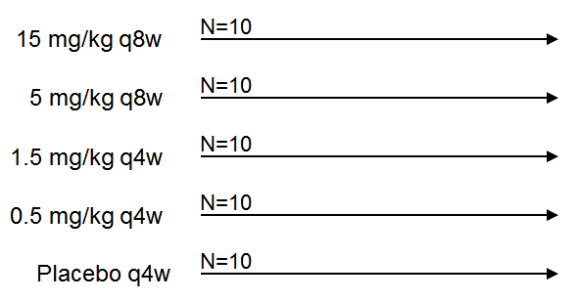
Design to be simulated
Readout of interest: PK, PD, Relative change in PD from baseline (%)
Targeted population
  Each dose group contains 5 male and 5 female subjects
 | Male, mean (std) | Female, mean (std)
Weight | 80 kg (12 kg) | 65 kg (14 kg)
Age | 60 years (15 years) | 55 years (15 years)
 | No correlation

Slide 26
Assumptions
We assume the following to be available
  An NLME popPK model, adequately characterizing the dose/concentration relationship
  An NLME popPKPD model, adequately characterizing the concentration/response relationship for a PD readout of interest with respet to the current clinical question
  Both NLME models are available as IQM NLME projects
    For this example the final PK and PD models from the IQM Tools tutorial number 4 (popPKPD are used)
  A structural model (IQMmodel) representing the PKPD model for the simulation and with same structure as the models used for fitting the parameters of the popPK and popPKPD models
We are interested in the expected outcome of a parallel design for repeated trial simulations, considering uncertainties in the population parameter estimates and population characteristics (covariates)

Slide 27
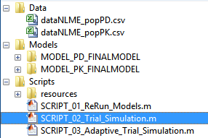
Parallel Design Simulation
Change into the Example Files/Clinical Trial Simulations folder
You will find the following contents
The Data folder contains the NLME datasets
that have been used for parameter estimation
for the final PK and PD model, used in this simulation
The Model folder contains the PK and PD NLME
models with parameter estimates from which to
sample for the trial simulation. These models
were developed in the example of Tutorial 4
The Scripts folder contains a script to re-run the model, if desired (not needed). Additionally the SCRIPT_02_Trial_Simulation.m for this Example 1. And the third script is for Example 2

Slide 28
Parallel Design Simulation
Have a look at the models in the Models folder
  The PK model is a MONOLIX model, the PKPD model is a NONMEM model. The trial simulation approach used in IQM Tools, does not make a difference between parameter estimation tools, but imports results from different tools via seamless interfaces
  The popPK model has weight at baseline (WT0) and gender (SEX) as covariates on some of the parameters
  The popPKPD model uses the covariates WT0, SEX, and age (AGE0) as covariates on the baseline estimate
Have a look at the PKPDmodel.txt file in the Scripts/resources folder
  This is the IQMmodel that is going to be used for the trial simulation in IQM Tools
  It has the same structure as the PKPD model that was used for fitting the PKPD NLME model

Slide 29
Parallel Design Simulation
Open the SCRIPT_02_Trial_Simulation.m in the MATLAB editor
Change line number 59 in the script to define the location where you have IQM Tools installed
In a classroom setting it is now time to switch to MATLAB and work through this example together
In a self study setting – please start reading, executing, etc.
  The script is well documented and should be fairly self explaining

Slide 30
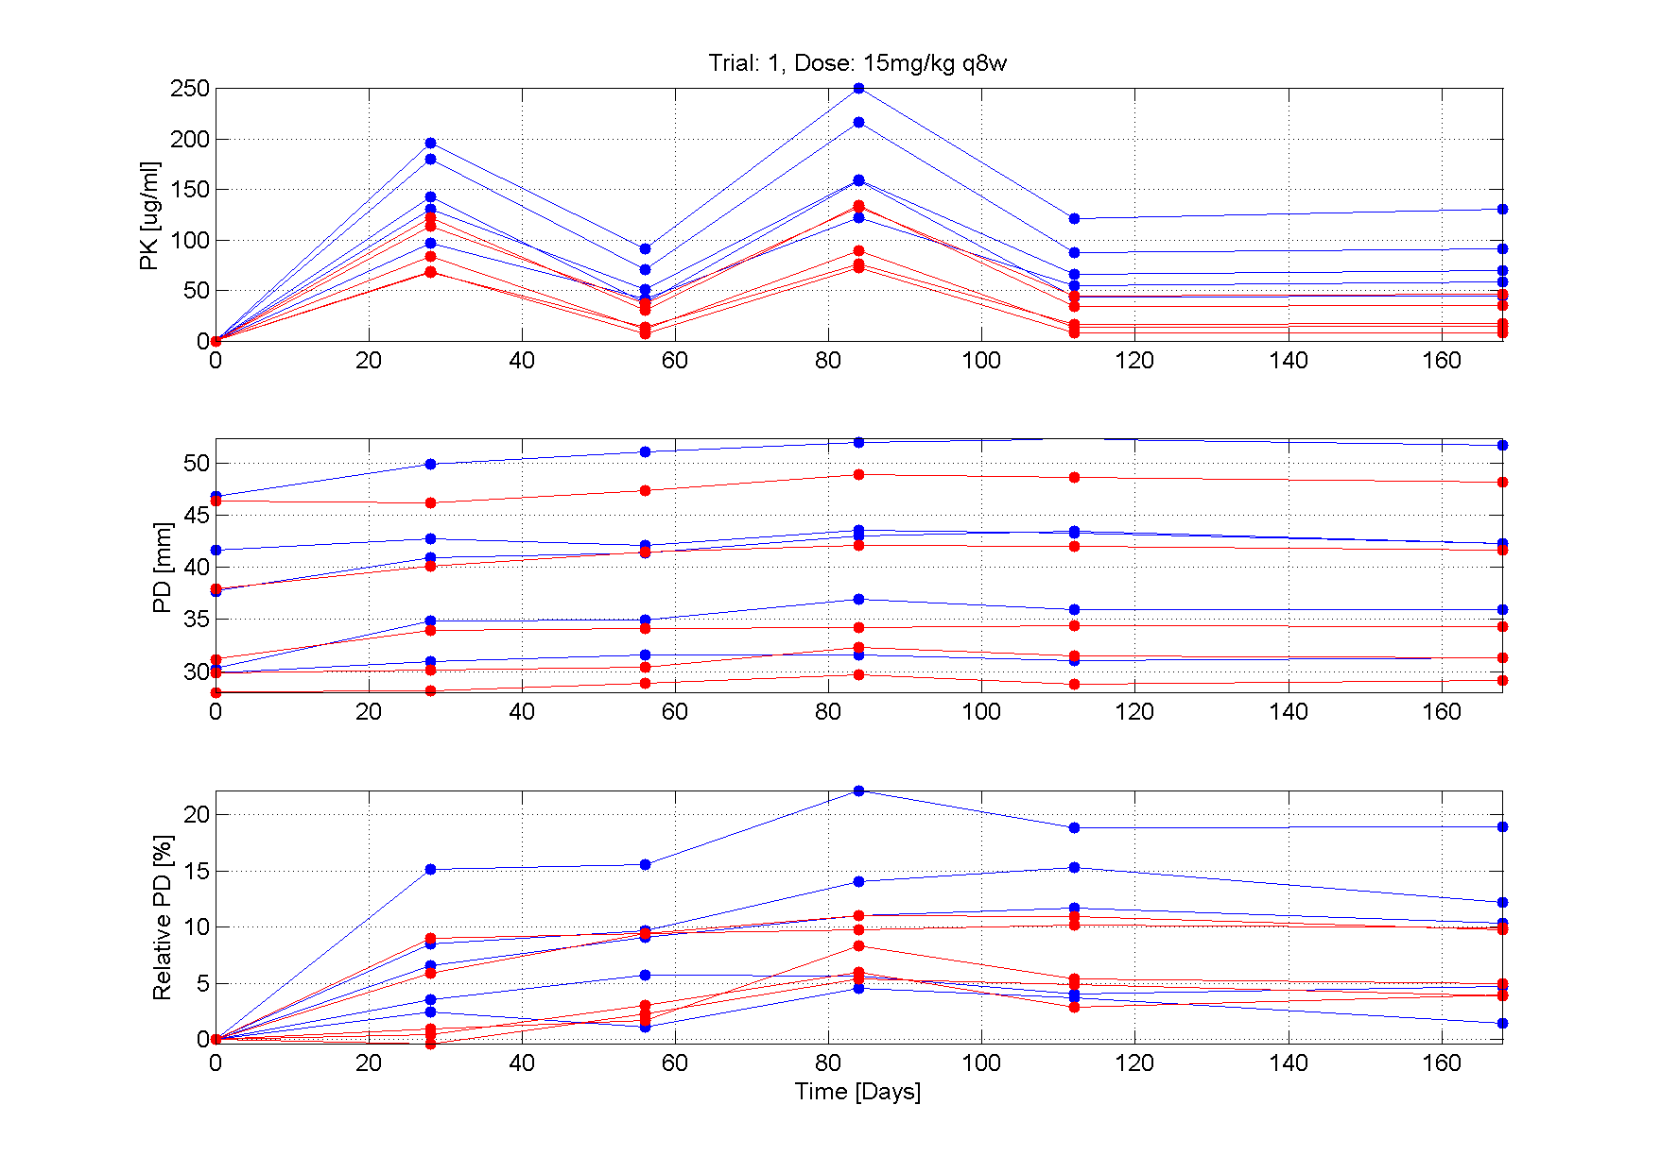
Results ...
This example focuses on the implementation of a reasonably simple parallel design clinical trial simulation
The only graphical output that is generated in this example is a plot of the individual PK, PD and relative PD profiles over time for trial 1 and dose group 5 (15mg/kg q8w dose)
Important is that all relevant data has been generated to allow for further post-processing – all in the context of the question of interest to address

Slide 31
Tutorial Outline
General introduction to the IQM Tools Suite
Overview Clinical Trial Simulation Approach IQM Tools
Example 1: Parallel Design
Example 2: Adaptive Trial Simulation

Slide 32
Design to be simulated
More complex, adaptive trial scenario
  50 subjects starting at lowest dose level (placebo)
  Rule for up-titration based on relative change from baseline until next scheduled dosing time
  End of study arbitraily set to 36 weeks
15 mg/kg q8w
5 mg/kg q8w
1.5 mg/kg q4w
0.5 mg/kg q4w
Placebo q4w
N=50
Up-titration to next dose level if PD change <3% from baseline
Assessment at each next scheduled dose time
End of study
4 weeks
8 weeks
12 weeks
16 weeks
20 weeks
24 weeks
time
28 weeks
32 weeks
36 weeks

Slide 33
Design to be simulated
Measures of interest at the end of the study (36 weeks):
  What are the expected numbers of subjects in each dose level (median and standard deviation across all trials)
  What is the median and the standard deviation of the simulated relative PD change in each dose group?
Targeted population
  Equal split between males and females (25+25) with the following properties
 | Male, mean (std) | Female, mean (std)
Weight | 80 kg (12 kg) | 65 kg (14 kg)
Age | 60 years (15 years) | 55 years (15 years)
 | No correlation

Slide 34
Adaptive Design Simulation
Open the SCRIPT_03_Adaptive_Trial_Simulation.m in the MATLAB editor
Change line number 58 in the script to define the location where you have IQM Tools installed
In a classroom setting it is now time to switch to MATLAB and work through this example together
In a self study setting – please start reading, executing, etc.
  The script is well documented and should be fairly self explaining

Slide 35
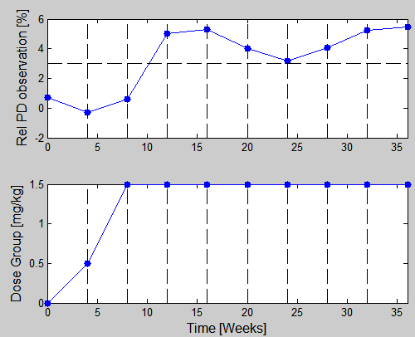
Checking the simulation
Uncommenting lines 275-294 in the script allows to check correctness of the implementation of the adaptive dosing scheme
Two example simulation results for individual subjects are shown below

Slide 36
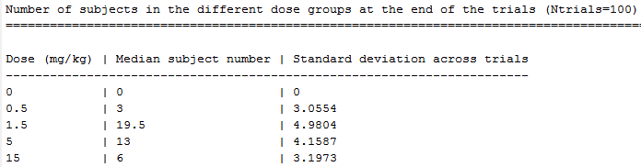
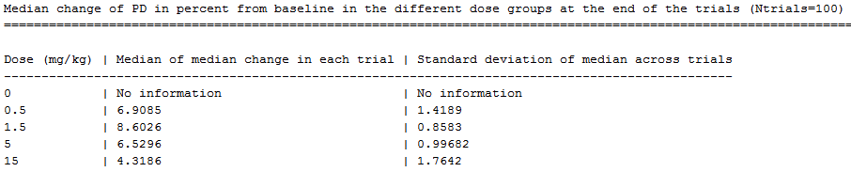
Results ...
Nothing fancy is provided in the post-processing of the results
  Table with number of subjects in the different dose groups at week 36
  Median change of PD in each dose group at week 36
    It is not surprising that subjects in the high dose group in average show lower efficacy. This can be explained by the fact that subjects who are not responding well to the treatment are more likely to be uptitrated

Slide 37
Tutorial Goal: „You should now be able to“
Understand the components that are used by IQM Tools for general clinical trial simulation
Reuse the code from the two examples and adapt it to similar trial simulations of your interest

Slide 38
THE END
Thank you for your participation and interest!
The tutorial continues in Part 6 (IQM Tools Pro / Linking Systems Pharmacology Models to Clinical Data)

